Slide 1

Silicon Chip (The Future Technology)
Afina Putri Dayanti
NIM : 825200049

Slide 2
What exactly are holograms?
Holograms is an image that appears to the naked eye to be three-dimensional
Holograms are created in a rather complicated process using lasers

Slide 3
What does the future hold for holograms?
Developer have high hopes for the new mobile communication standard 5G
5G network can transfer huge amount of data at incredible speed making things like holographic chat more achievable

Slide 4
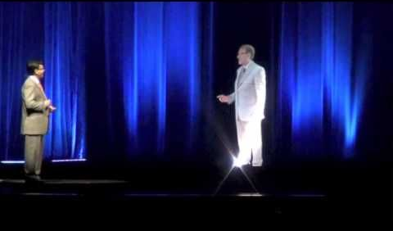
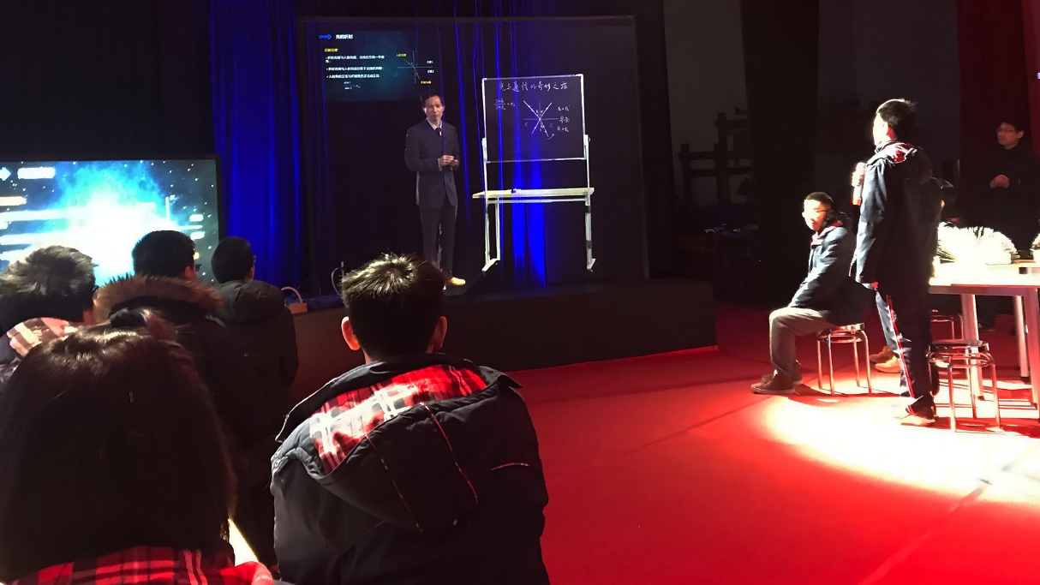
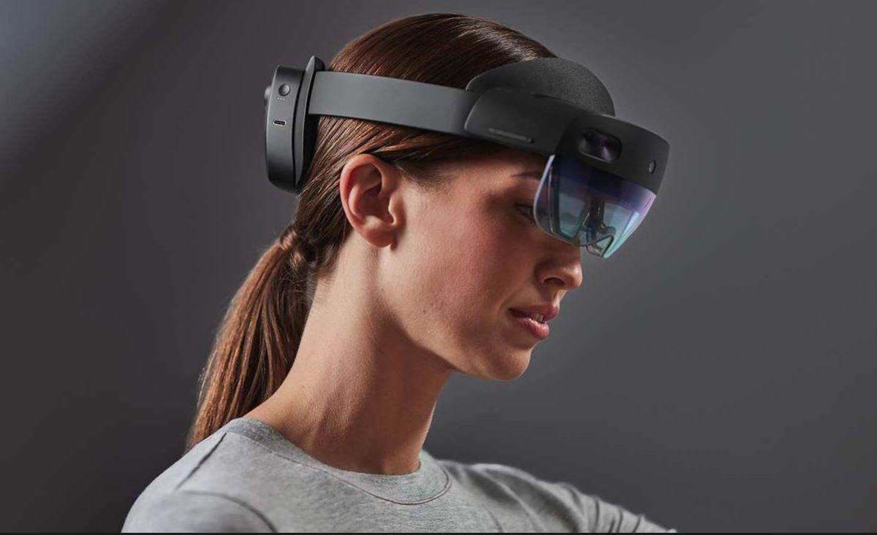
One step further

Slide 5
Source
https://www.youtube.com/watch?v=NlO9F-gl9e4

